Slide 1
Christian-Gymnasium Hermannsburg Vocational Preperation at our school
Made by Franziska Makiolczyk, Meret Eggers and Thalea Bein

Slide 2
Vocational Preperation
WORK EXPERIENCE
“Zukunftstag“
individual work experience
presentation of nearby companies
APPLICATION
coaching the students how to write a letter of application
individual application training
CAREER GUIDANCE
voluntary and individual guidance
career guidance in year 9 and 10
„Hochschulinfor-mationstag“

Slide 3
“Zukunftstag“
Former “Girls Day“

Slide 4
“Zukunftstag“
One day work experience
- every year from year 5 to 9
- students get a day off from school and use the opportunity to work in any job they like
possibility for the students to get an insight into different jobs to discover individual interests for their future job

Slide 5
Year 9

Slide 6
Year 9
Writing an application
Cover letter
Curriculum Vitae
in cooperation with the job center, the students receive career guidance

Slide 7
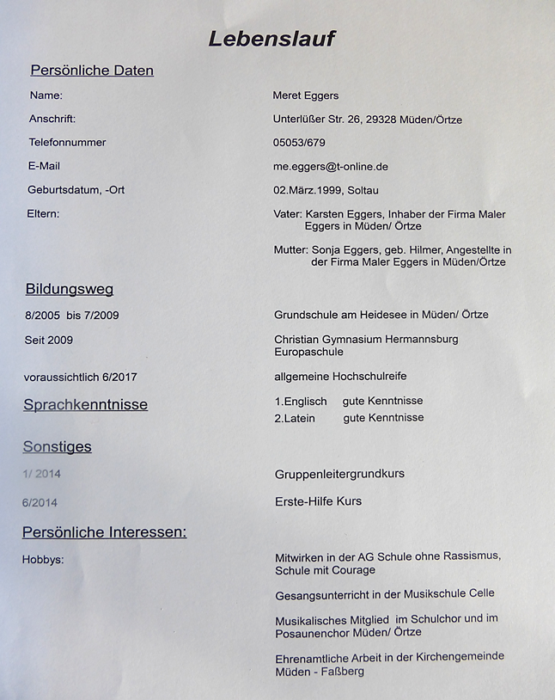

Slide 8
Year 10

Slide 9
Year 10
Mandatory internship
work experience of two weeks in a specific job (everyone)
they can choose any job
report and presentation about their experience
students experience working life more intensively and some even end up with a job offer for their future

Slide 10
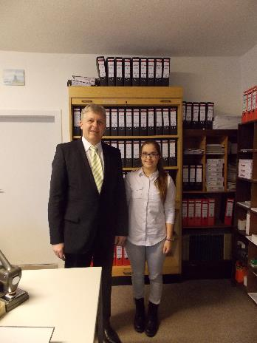
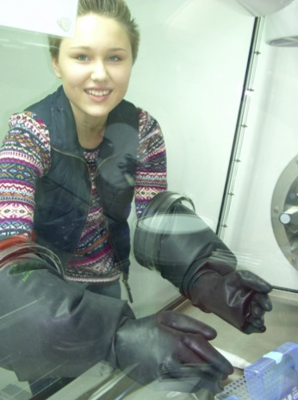
Year 10

Slide 11
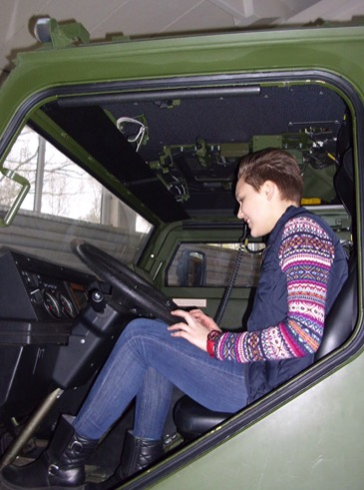
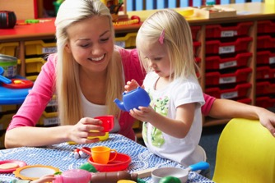
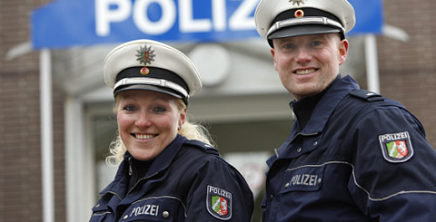
Year 10

Slide 12
Year 10
Job center
cooperation with local employment
center („Job Center“)
students receive career guidance

Slide 13
Year 10
Politics (subject):
teaching unit on vocational preparation and orienteering: expectations of future employers, reflection of own expectations and skills, presentation of different work fields (training, wage, …)

Slide 14
Year 10
MIG
Management Information Game: simulation of product presentation (students take over role of companies)

Slide 15
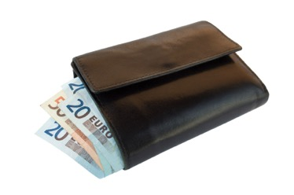
Year 10

Slide 16
Year 11 & 12

Slide 17
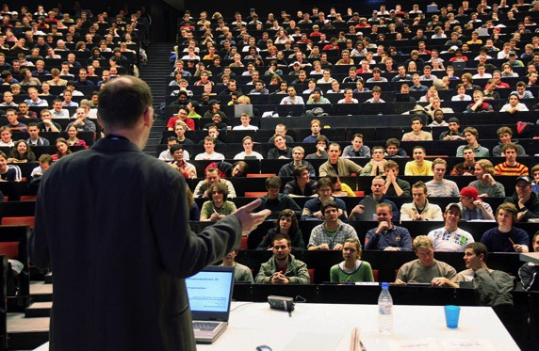
Year 11 & 12
“Hochschulinformations-tag“
visit of a nearby university
diverse lectures
overview of nearby university

Slide 18
Year 11 & 12
cooperation with “Europe Direct”
representative comes to school and informs students about career opportunities (internships, job chances) in Europe after school

Slide 19
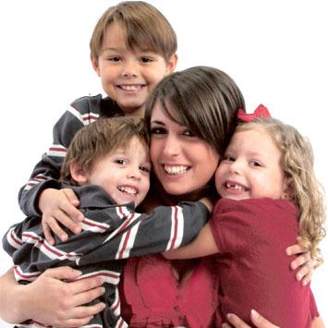
Year 11 & 12

Slide 20
Year 11 & 12
application training
preparation of job interview
individual preparation, with regard to content (information on company, …) and personal matters (appearance, clothes, behavior, gesture, …) as well as time management etc.

Slide 21
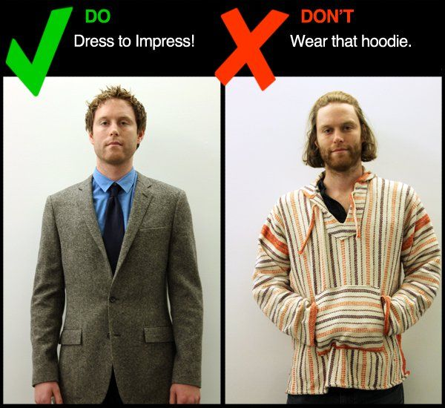
Year 11 & 12

Slide 22
Further activities
cooperation between our school and the “Arbeitskreis Schule und Wirtschaft“ (research group school and economy)
regular meetings between companies and teachers
CGHonig
school company – students supervise our own beehive, produce honey and sell produced honey

Slide 23
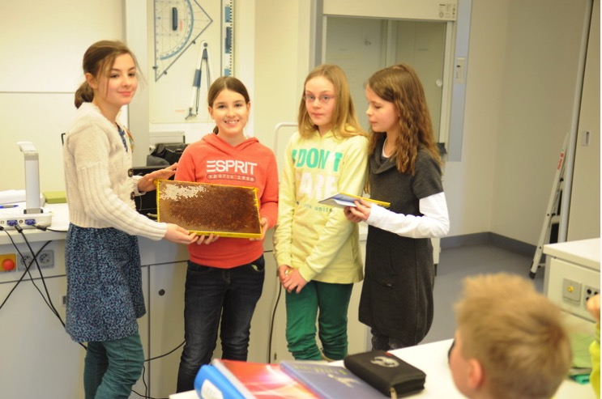
CGHonig

Slide 24
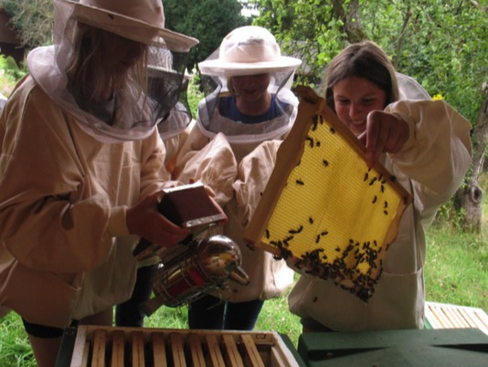
CGHonig

Slide 25
Danke! Grazie! Dziękuję! Dank je wel!
Thalea Bein, Meret Eggers & Franziska Makiolczyk

