Slide 1
Career perspectives in Europe-Chances and challenges
Working abroad perspectives

Slide 2
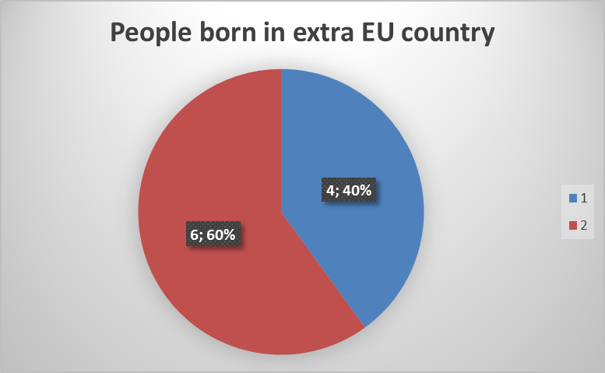

Slide 3
Which was the last country where did you live?
Most of the people we interviewed the last country where they lived was in extra-EU countries such as Australia or Syria.

Slide 5
Why did you choose Italy?
Most of the people we interviewed about the reason why they chose the Italian told us that they came here to work or for increase their level of education or for love.

Slide 6
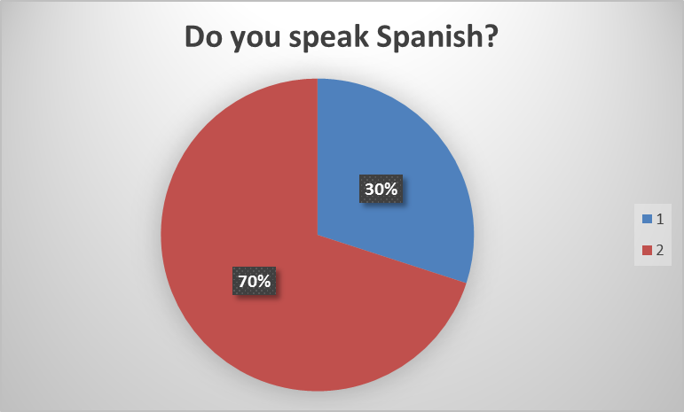

Slide 7
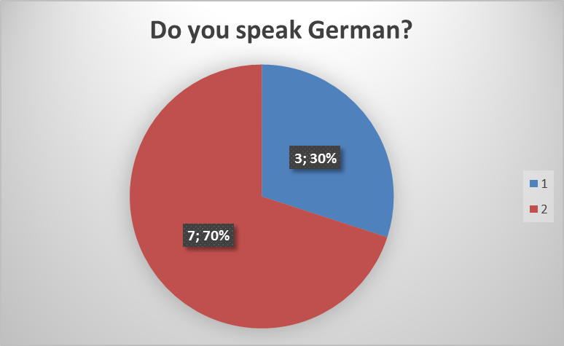
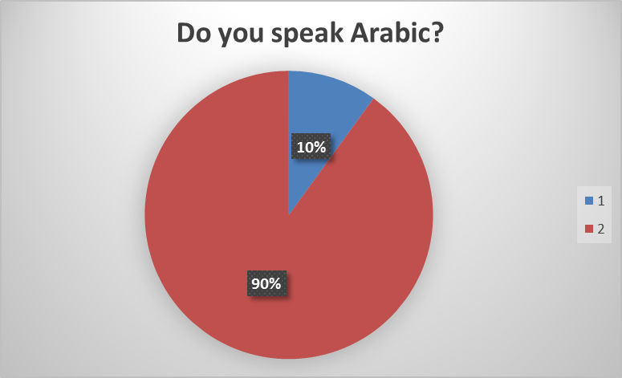

Slide 8
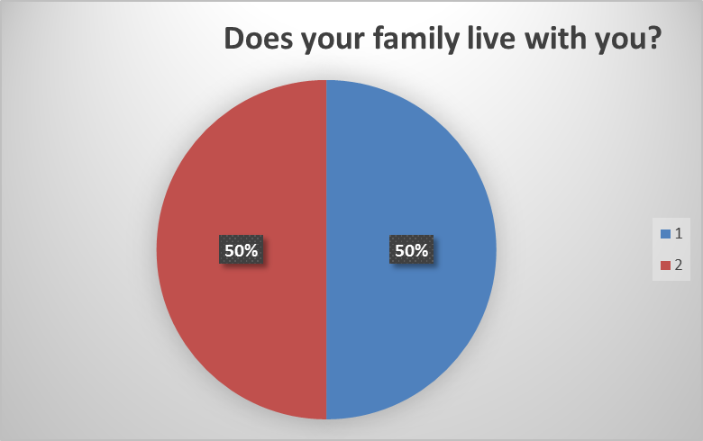
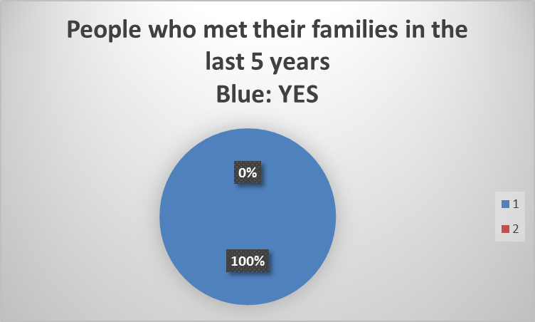
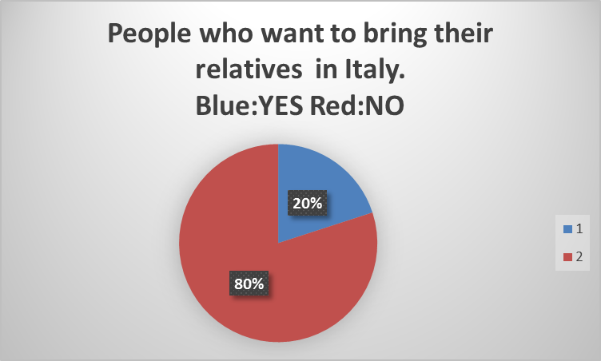

Slide 9
How did you arrive in Italy?
Most of the people we interviewed about how they have arrived in Italy told us they arrived by plane except one person by train.

Slide 10
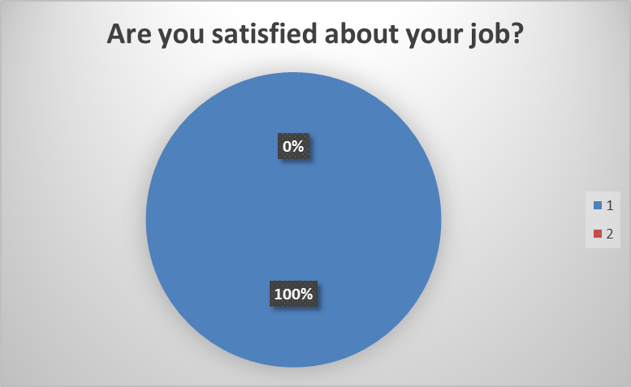

Slide 15
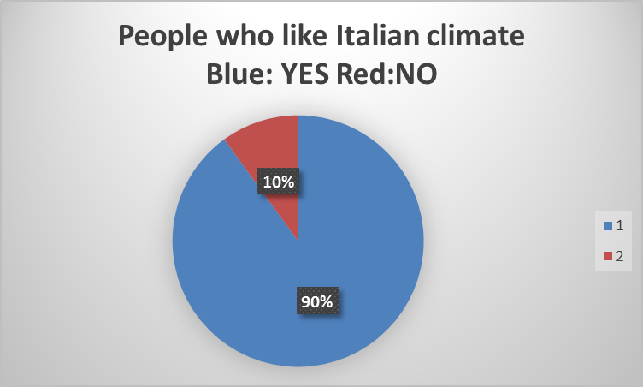

Slide 16
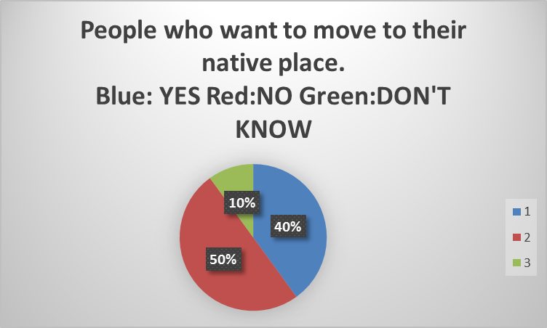

Slide 17
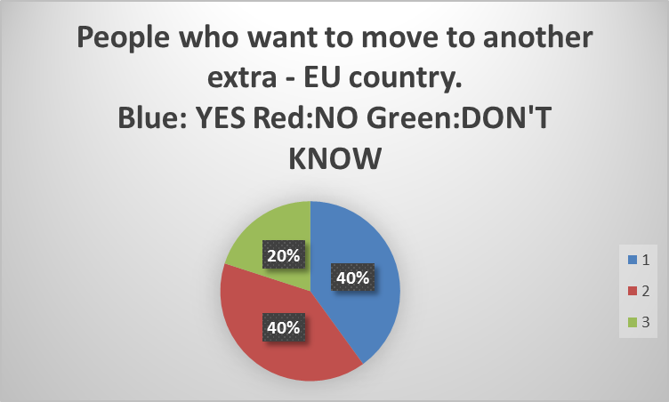

Slide 20
Thanks to everyone for listening. We hope you’ll have a good school year.
GOOD LUCK

