Slide 1
Free mobility
Germany and Europe

Slide 2
Structure:
Definition of free mobility
Reasons for going abroad
Advantages for the EU
Disadvantages for the EU
Advantages for Germany
Disadvantages for Germany
7. Our solutions
Letters to politicians in the EU

Slide 3
Definition of free mobility:
People are allowed to move to other countries in the EU and work there without requiring any visa.

Slide 4
Reasons for going abroad:
most qualifications are accepted across Europe
no discrimination between native and migrant workers
people can spend their pension in other countries
big differences between the income levels of the European countries

Slide 5
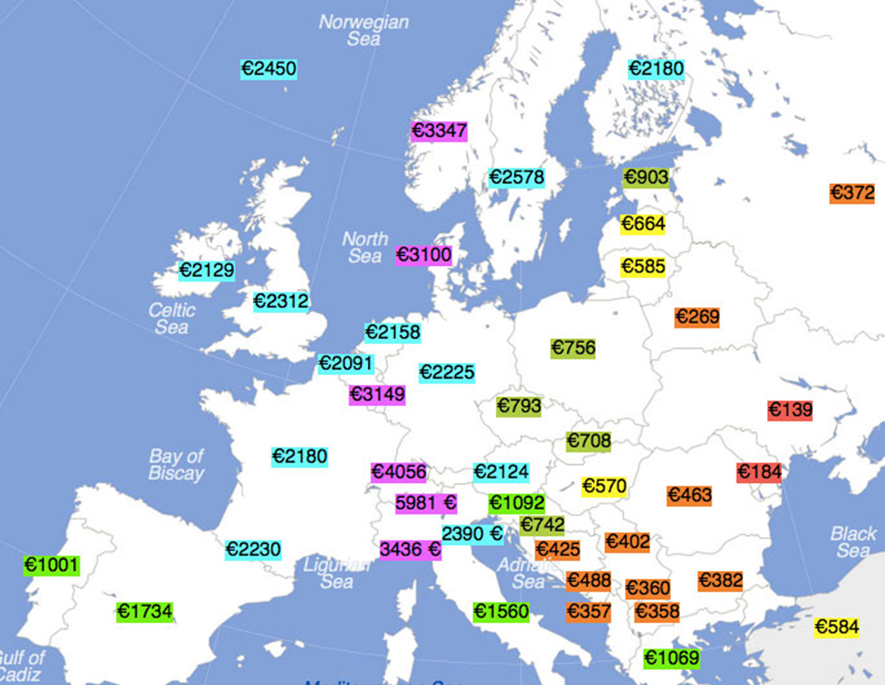

Slide 6
Advantages for the EU:
unemployment rate decreases
more flexible labor markets
could help to reduce regional inequalities
fill undesirable jobs
can prevent wage inflation

Slide 7
Disadvantages for the EU:
bad working conditions
more immigration ➤ more unemployed people
not enough workers if many people go to other countries
it‘s hard to settle and gain ground in the new country

Slide 8
Advantages for Germany:
more skilled personnel
better chances for smaller companies to deal with competitive companies in the EU
more competition ➤ cheaper products
improvement of efficiency
millions of jobs are saved
ensures the good economy in Germany ➤ role model for other countries

Slide 9
Disadvantages for Germany:
less employment
difficult to find work for unqualified people
production is outsourced to other countries
quality problems
products are too cheap

Slide 10
Our solutions:
better education ➤ more qualified people
more support from the government/laws against too cheap prices
more attractive places for companies to settle on the long run
more support for domestic companies, less for foreign companies

Slide 11
Our letter to politicians in the EU:
portrays our project “Career Perspectives in Europe – Chances and Challenges“ and our topic “free mobility”
includes advantages and disadvantages for Europe and Germany
questions:
What are your experiences with this topic?
Which positions and initiatives should the European parliament develop concerning free mobility?

Slide 12
Answer number one: DIE LINKE (German party)
European parliament decided to facilitate the free movement of labor
the political party DIE LINKE sees the free movement of labor as a basic human right in the EU
there have been obstacles
employees shall earn the same money in the same places
they shall have the same labor conditions
European Commission wants to promote the free movement to react to the skill shortage in European countries

Slide 13
Answer number two: DIE GRÜNEN (German party)
freedom of movement for employees
diminishing inequalities in the member states regarding payment, conditions etc.
leads to the development of chances
every EU country has different social security and working conditions
equal social securities and working conditions are needed
right wing populism

