Slide 1
ERASMUS+ 2015-1-DE03-KA219-013522_5
"Career perspectives in Europe - Chances and challenges"
Adressing occupational struggles of Italian young people
Notes:
1

Slide 2
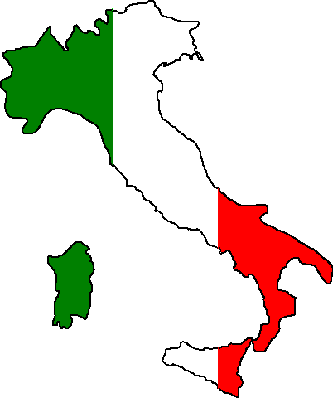
Italy is a country with a lot of potential in many fields: culture, natural scenaries and scientific knowledge of our country rappresent the engine which could allow
this nation to become an international leader. The main obstacle to the fact that this happens is the bad political and bureaucratic management of the country.

Slide 3
The flawed and chaotic bureaucratic system in Italy has led this country to the loss of it’s main development power source: the younth

Slide 4
One of the main causes of this is the bad management of the school system which has led the latest generations to lose confidence in the italian system, so the youngsters have lost the passion in the education

Slide 5
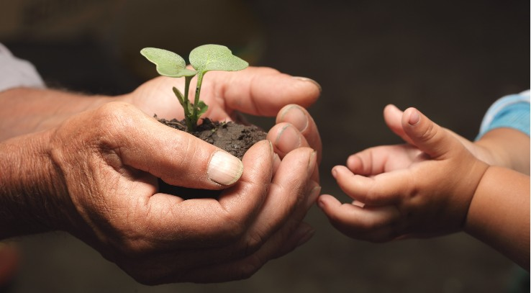
Once they get a degree it is difficoult for the Italian youngsters to become part of the working community. So the relatively old age of the workers in Italy doesn’t allow the more innovative and young minds to succeed.

Slide 6
Furthermore the ill-managed bureaucracy makes extremely difficult to have a stable future for the new generations of this country. Data from 2016 show that the balance between the our country coming and leaving researchers is equal to a -13%.

Slide 7
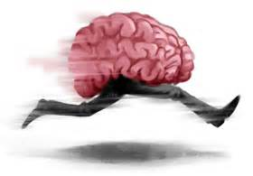
The italians that tend to look for a job abroad are more or less all people that have just get a degree and young researchers that find it more likely to cultivate their knowledge in countries like the U.S.A., Great Britan, Germany and France. Every year approximatly 3 thousand italian researchers choose the path of working abroad. This is the worst figure in Europe.

Slide 8
There are individuals who have decided to leave Italy in order to look for workplaces where competence and merit are more appreciated. These people often find their destination in occidental countries, but also in South America and Asia.

Slide 9
This situation obviously leads to the absence of Italy in the world wide scenery as a place of reception of new minds for the purpose of Increasing production of innovations.

Slide 10
The desire of us, the youngsters, is of being able to plant our roots in Italy and that this country give us the opportunity to grow. For us it is really important that there is an investment in us and in the improvement of the scholastic system.

Slide 11
Thank you for the attention!
Notes:
11

