Slide 1
questionnaire
My future and I

Slide 6
24%

Slide 10
Other:
undertaker
photographer
tattoo artist
no-job
paramedic
waiter
businessman
astronaut
cosmetologist
game designer
teacher
pilot
baker

Slide 11
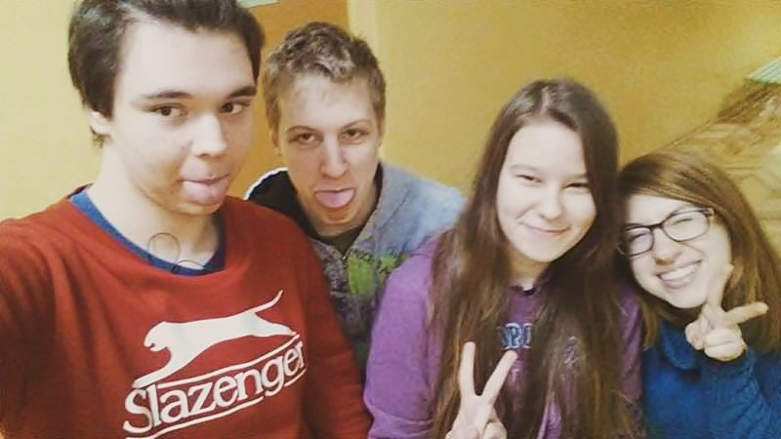
Thanks for your attention!

