Slide 1
Going Abroad

Slide 2
Content
Reasons
Requirements
Examples
volunteering
working
studying
Personal experience

Slide 3
1. Reasons: Why Should you go abroad?
Fun
Experience
Learning
a
new
language
Curriculum
vitae

Slide 4
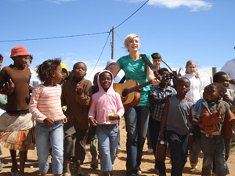
2. Requirements: You should be…
• open minded
• curious
• proactive
• willing to plan

Slide 5
3. Examples: Going Abroad – But how?
Volunteering
Working
Studying
EVS
German organisations like “weltwärts“
work & travel
workcamps
aupair
work experience
How?
Where?
Erasmus?

Slide 6
Volunteering
EVS
Kulturweit & Weltwärts

Slide 7
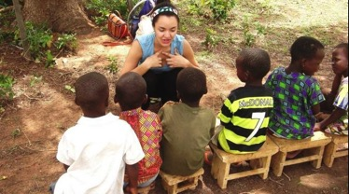
Volunteering abroad
Volunteering
What is a volunteering service ?
2 kinds of volunteering
EVS and IYVS
WOOFEN
Kulturweit and Weltwärts

Slide 8
What is a volunteering service and why should you do it ?
Volunteering
do something voluntarily, mostly some kind of charity work
a first insight into “real life“
meet new people
get to know a new country/culture
learn a new language

Slide 9
2 Kinds of volunteering
Volunteering
Lawfully controlled volunteering
Not lawfully controlled volunteering
you don‘t have to pay everything on your own
you get financial help from the EU or your country‘s government
your time abroad is well organized by government
organisations give you a place for 2 to12 months all over the world
you have to pay for everything on your own
it‘s recommended to build up a circle of sponsors (friends and family) to finance the trip

Slide 10
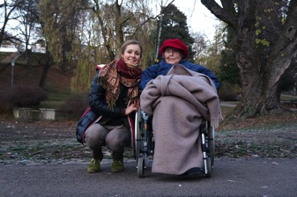
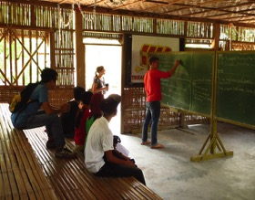
Volunteering
European volunteering Service
International youth volunterring service
you work in a charity project (social, cultural…)
attend a language course
you have to be 17
application 6 to 8 months in advance
in European countries 2 to 12 months
only pay a part of travel costs
quite similar to EVS
application up to 12 months in advance
up to 1 ½ years abroad
all over the world
costs are covered by EU
for additional cost --》 circle of sponsors

Slide 11
Volunteering
Kulturweit
Weltwärts
in a cultural institution in a third world country
minimum age: 18
final examination necessary
knowledge of English and the native language (min 1)
application 1 year in advance
½ to 1 year abroad
costs are subsidized by kulturweit
development work in third world countries (health, education, human rights...)
minimum age: 18
“Abitur” or other final exam
basics of the native language
application ½ to 1 year in advance
up to 2 years abroad
all costs are covered

Slide 12
Working Abroad
Work & Travel
Workcamps
Au Pair
WWOOF

Slide 13
Training
Working
Reasons: - experience - earning money
Requirements: - be 18 - good language skills
Application: - 6 months in advance
Erasmus is funding trainings

Slide 14
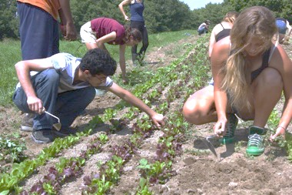
Casual Work Abroad
Working
Reasons:
meet new people
Travel country
Requirements:
be 18
basic knowledge in national language
Possibilities:
many opportunities to work abroad
Application:
3 to 6 months in advance

Slide 15
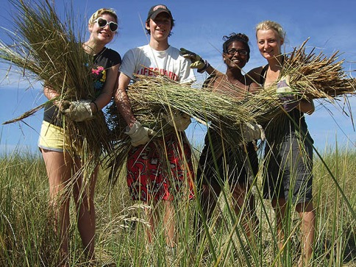
Workcamps
Working
Reasons: - get to know new people/ cultures
Requirements: - be 18
Possibilities: - working in a group - different options
Application: - 2 to 5 months in advance

Slide 16
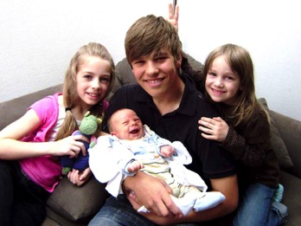
Au Pair
Working
Description:
someone who takes care of host family‘s children
Requirements:
between 18 and 30
knowledge in foreign language
experience in childcare
Application:
3 to 6 months in advance

Slide 17
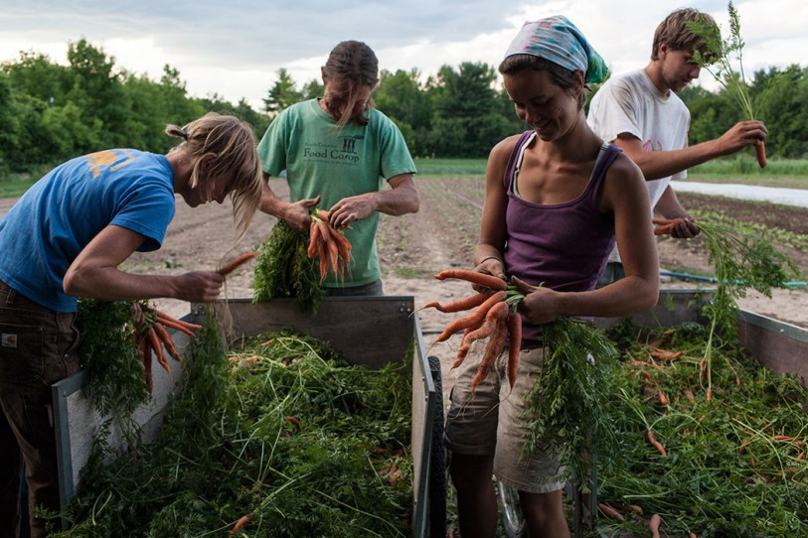
Wwoof (World wide opportunities on organic Farms)
Working
you work on a farm somewhere around the world
~6 hours a day for accomodation and meals
you have to be 18
knowledge of some English and even better of a native language
application a few weeks in advance
few days at one farm and then move on
90 countries all over the world
small membership fee
you have to pay everything (travel costs, insurance...)

Slide 18
Studying
Studying

Slide 19
Studying
Studying
Reasons: - better language skills
Requirements: - A-Levels - knowledge of foreign language - be 18
Application: - 9 to 12 months in advance
Erasmus?

Slide 20
4. Personal Experience
Jana

Slide 21
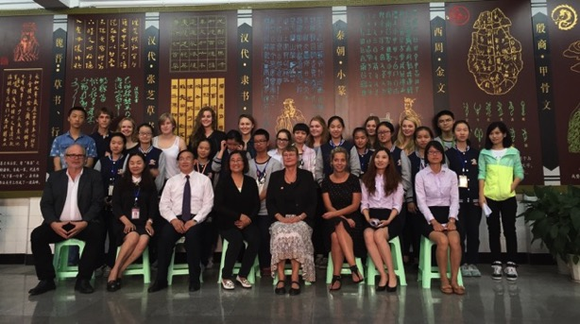
Personal experience
Julia

Slide 22
Personal Experience
Jakob

Slide 23
What are your future plans?

