Slide 1
career prospects In our school

Slide 2
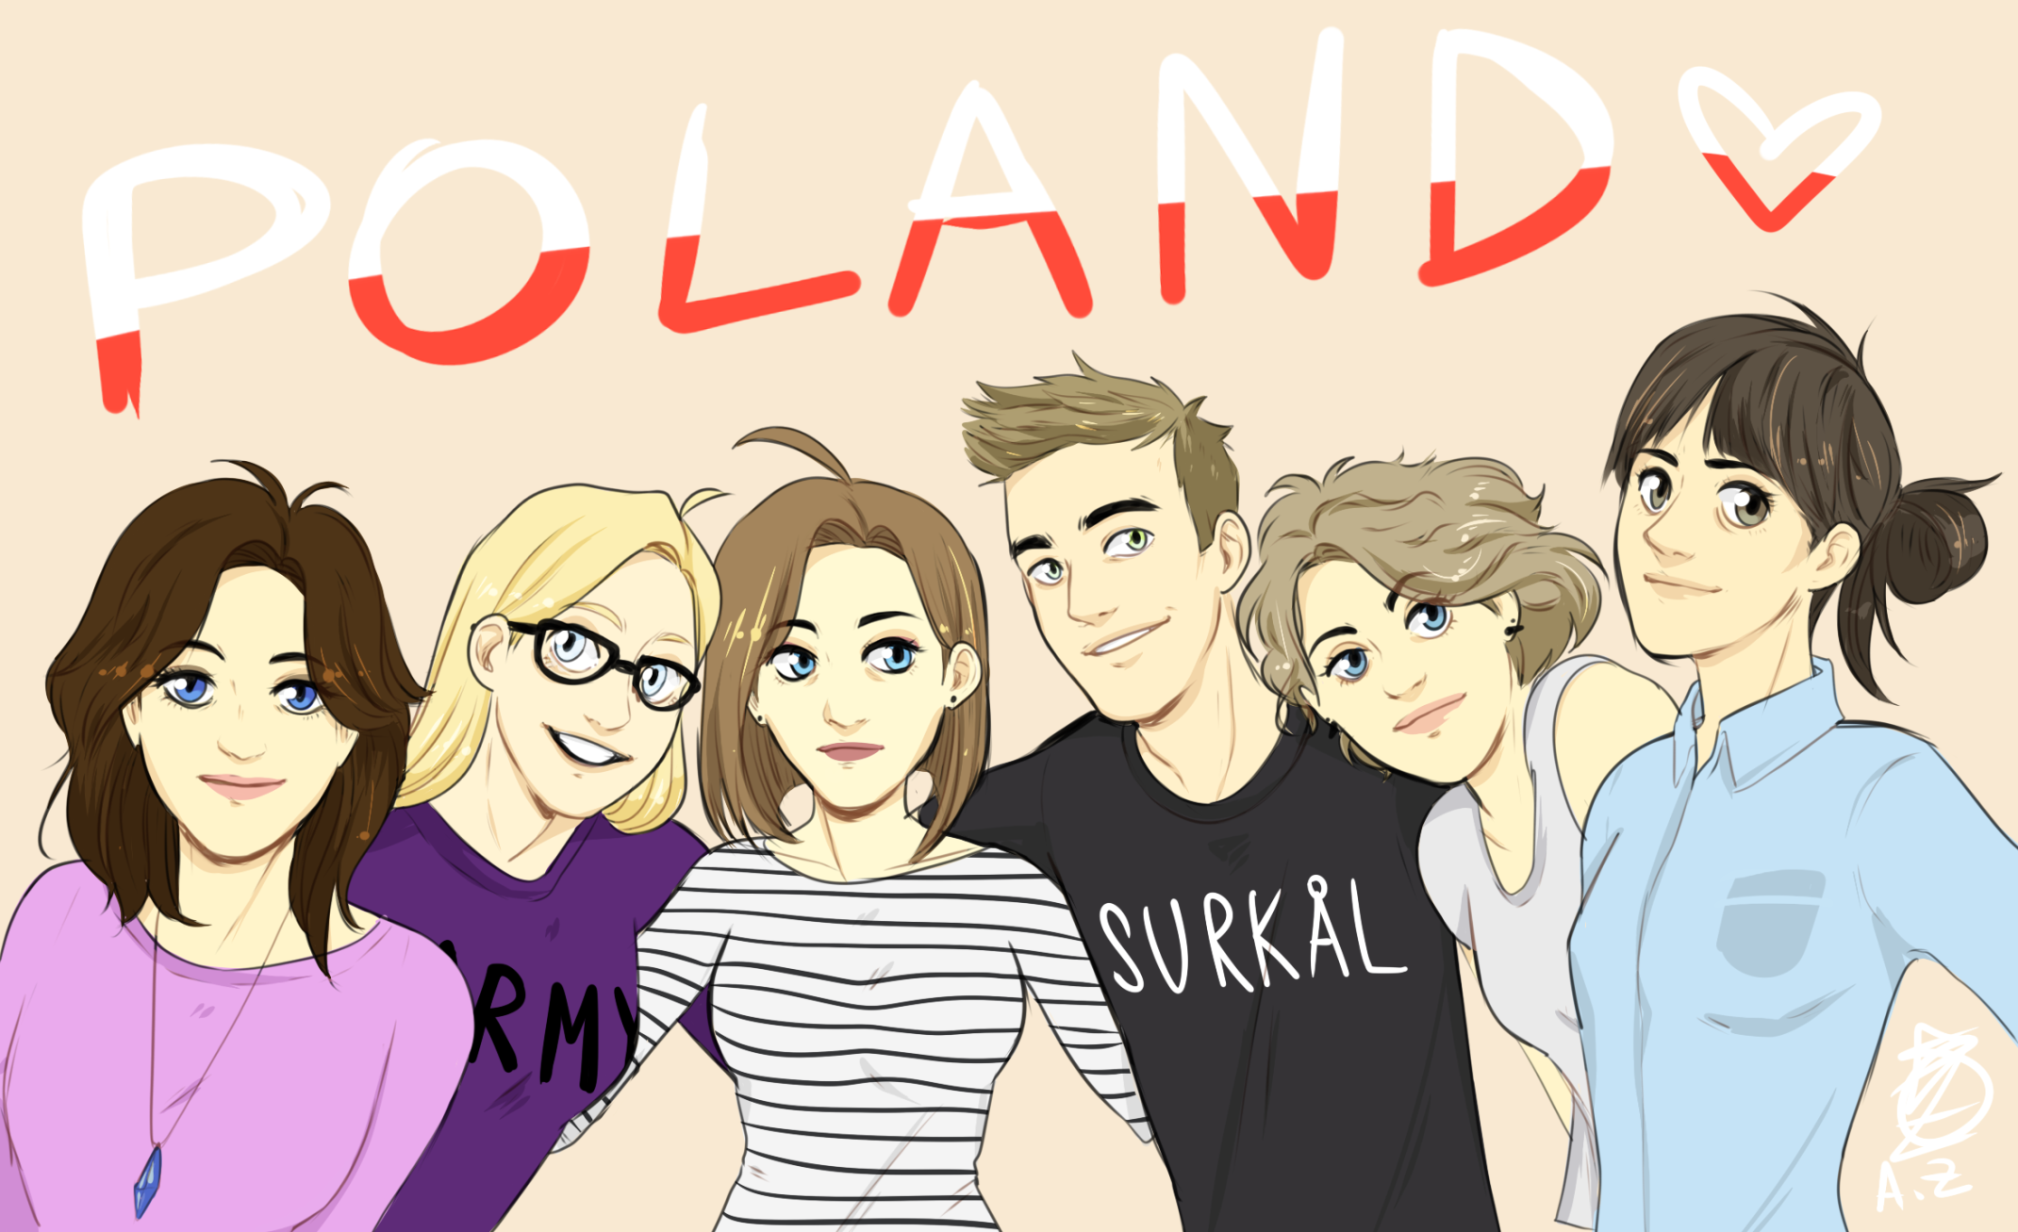
WE ARE FROM

Slide 3
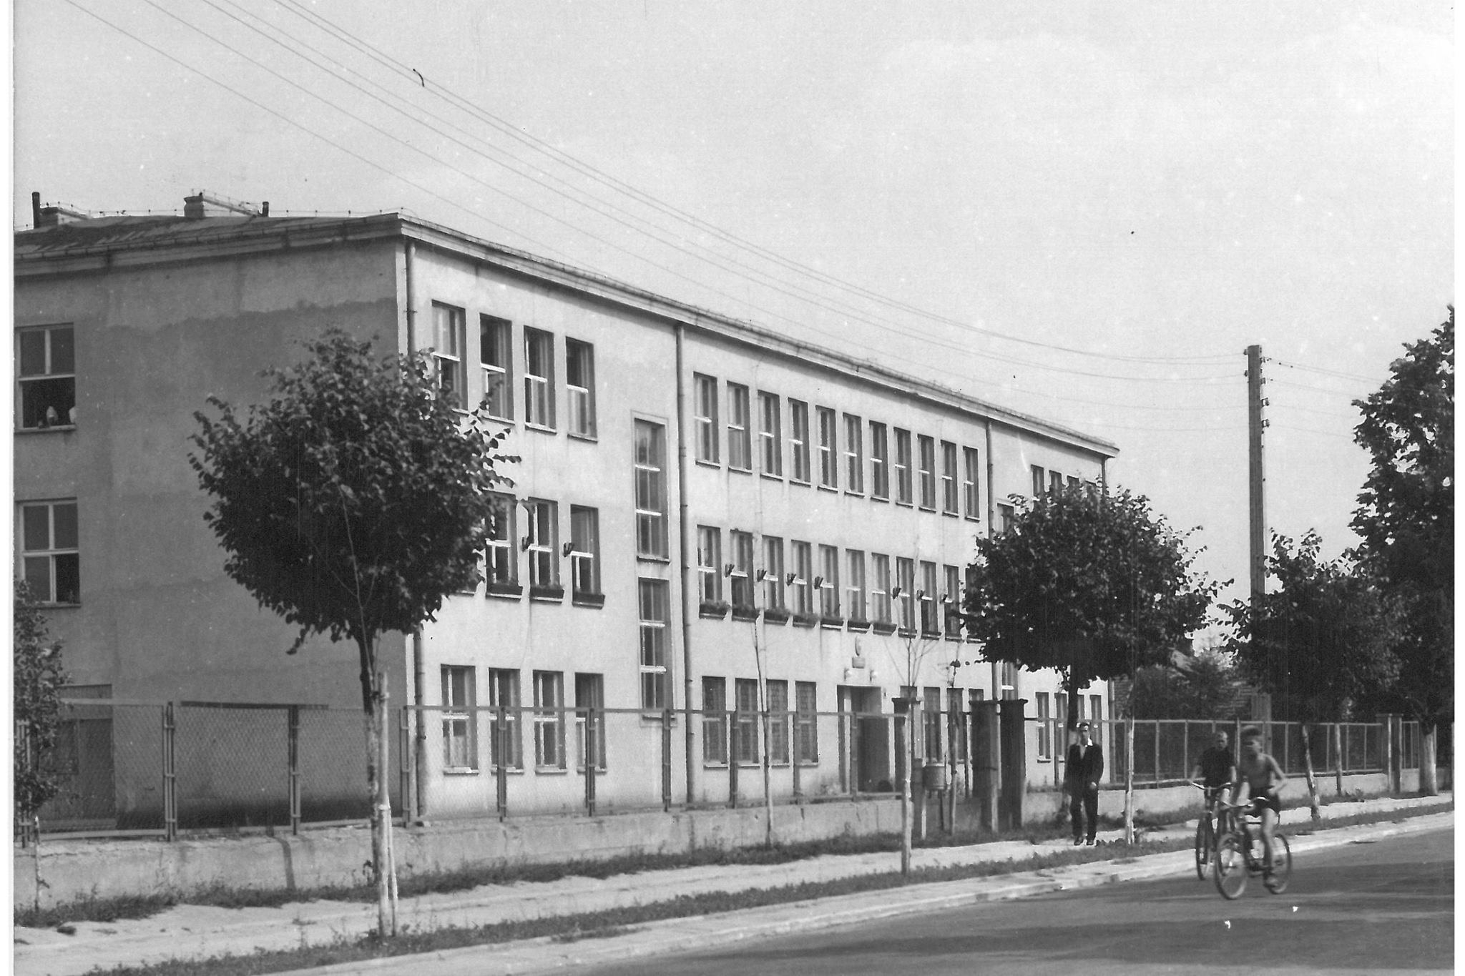
Our high school named after Maria Sklodowska Curie is located in Hajnówka. The school has been in existance since 1939. During the war its activity was suspended until 1943.

Slide 4
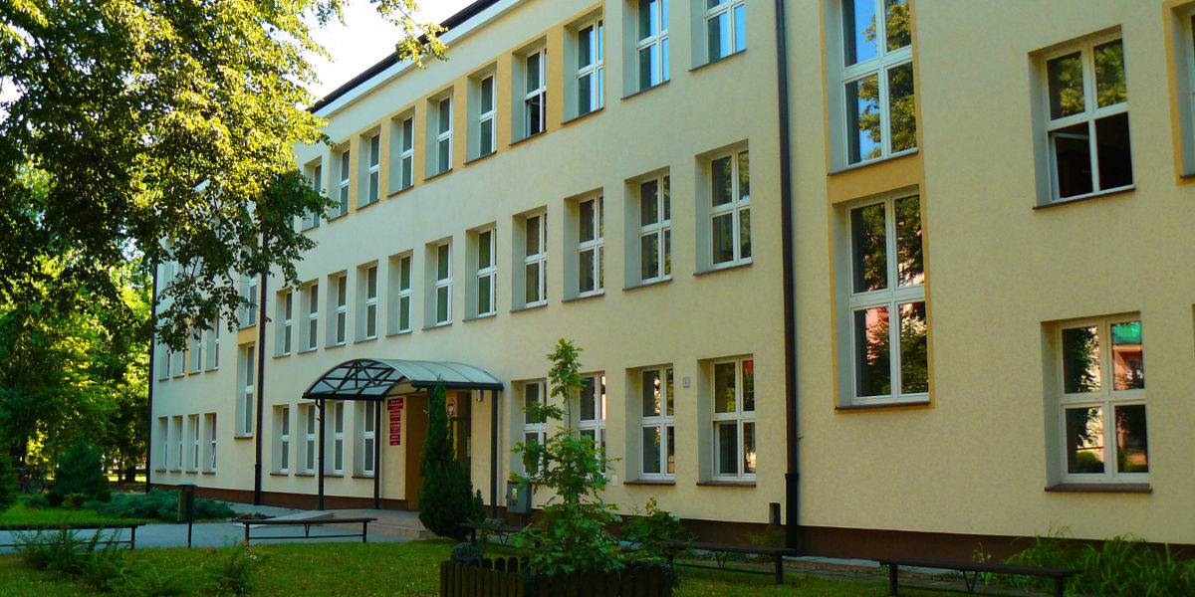
At present, OUR SCHOOL looks like this:

Slide 5
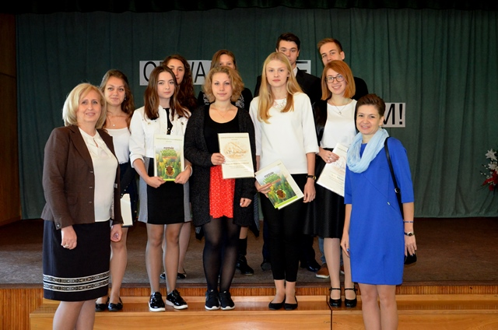
Our school tries to help us with our future career. That is why many projects are initiatied here. They allow our students to find their passion and choose future work. For example, there are special counseling classes.

Slide 6
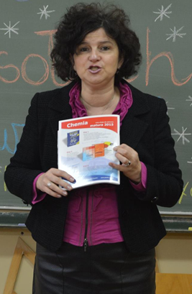
Career advice
What is it all about?
It is a process in which a counselor or a teacher helps the student achieve better understanding of themselves. Students also gain more knowledge of the working environment. The goal is to show realistic chances of employment and also link them with talents, interests and expectations.

Slide 7
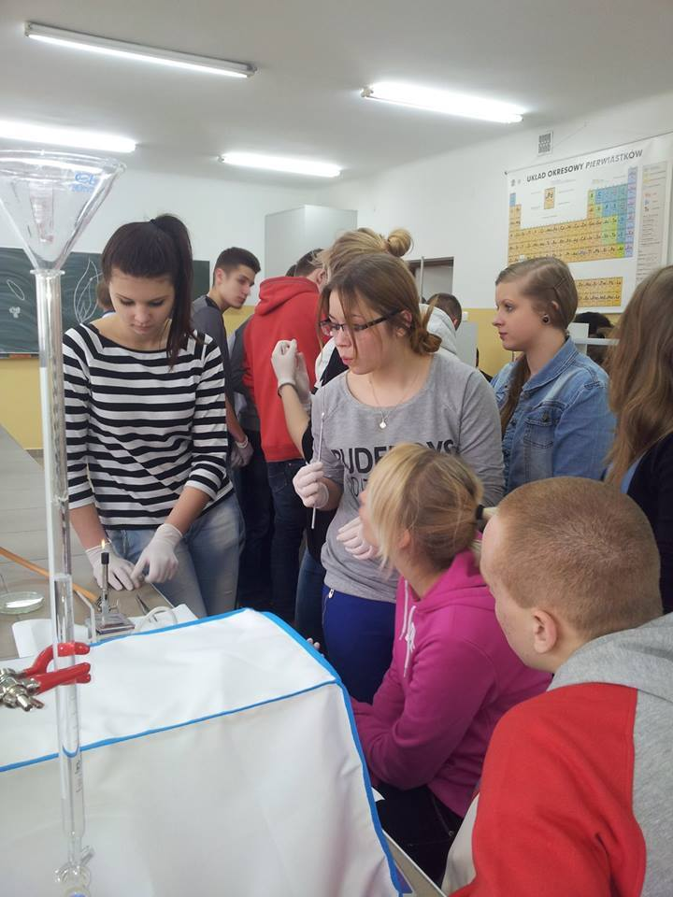
Our school supports and prepares students to making educational decisions. It also helps in planning career's development
Teachers provide assistance in creating and fulfilling educational plans,
They help shape behaviours and social skills required in the future professional environment,
They create conditions to help students know themselves, their capabilities and skills and to decide how to use them in the future.

Slide 8
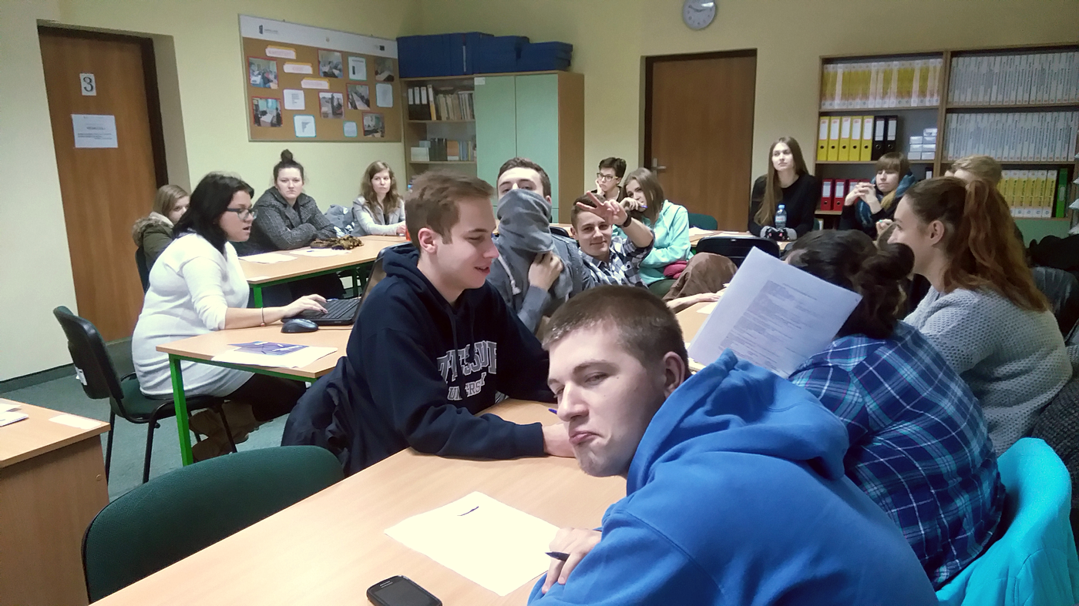
CAREER projects in our school

Slide 9
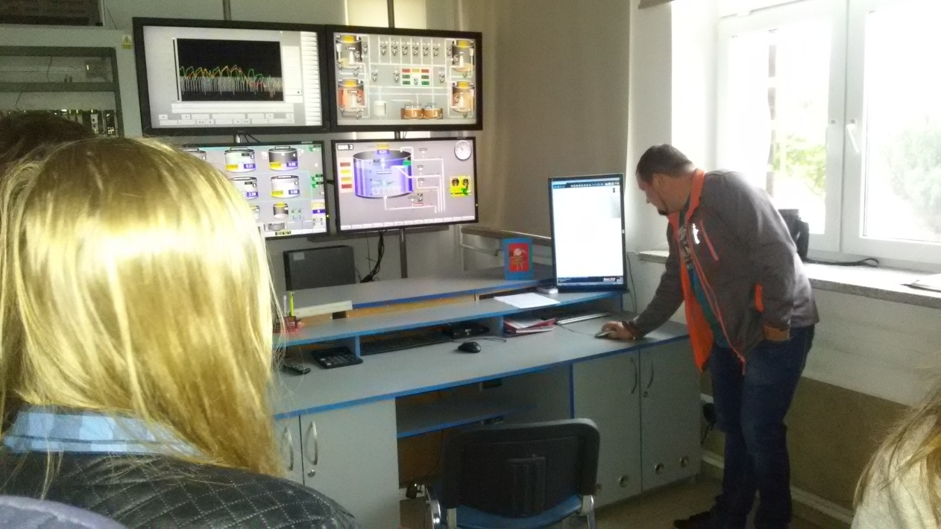
Classes with a career counselor in the Youth Career Center.
Meetings with employers and graduates of our school.
Workshops on entrepreneurship – Workshop „Creating aware enterpreneurship amongst youth"
Youth mini-enterprise.
Classes with school tutor and form teacher.
During the classes of Enterpreneurship’s Basics and Economics in Practice our students acquire skills and knowledge.

Slide 10
Classes with a career counselor in the Youth Career Centre
Group tutorials
Individual tutorials
To stimulate the enterprising spirit and active job search,
To provide educational and vocational information,
To present methods of career planning, searching and applying for a job.
To serve as a guide for young people, helping them find full-time, seasonal, part-time and short-term jobs,
To raise awareness of the labour market.

Slide 11
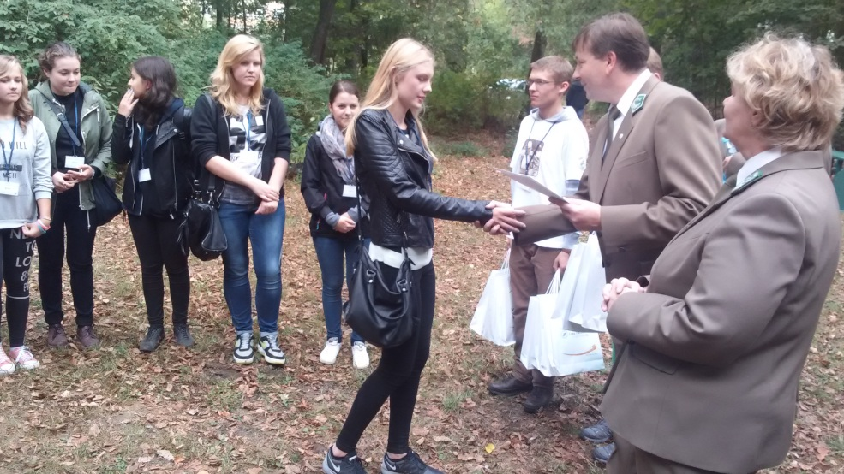
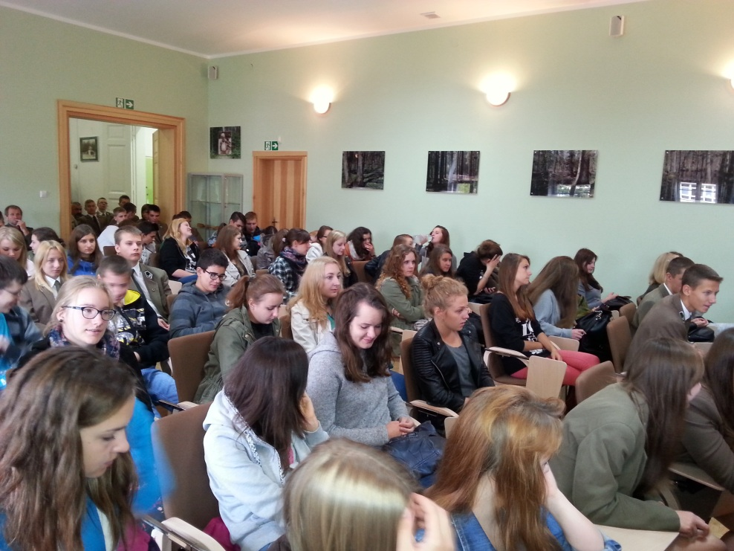
Meetings with entrepreneurs, representatives of various occupations and OUR graduates :
They show teenagers possible career paths.
Help students acquire knowledge about various occupations.
They also present pros and cons of being an entrepreneur.
They help students understand how companies work.
They present people who succeeded in business.

Slide 12
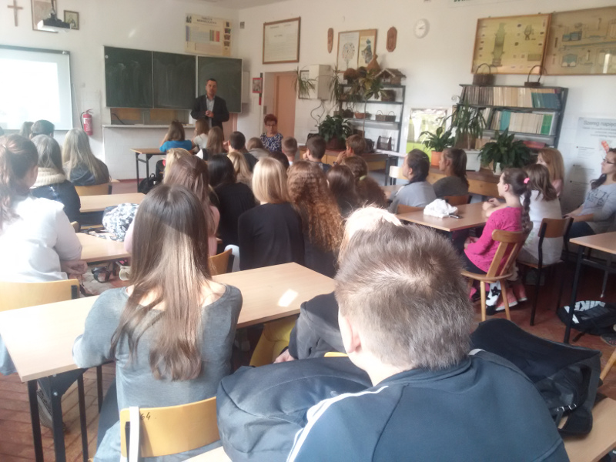
Workshops on entrepreneurship – Workshop „Creating aware enterpreneurship among young people"
Extra classes for those who want to learn about:
legal aspects of starting and managing a business,
EU fund raising,
creation of a brand.

Slide 13
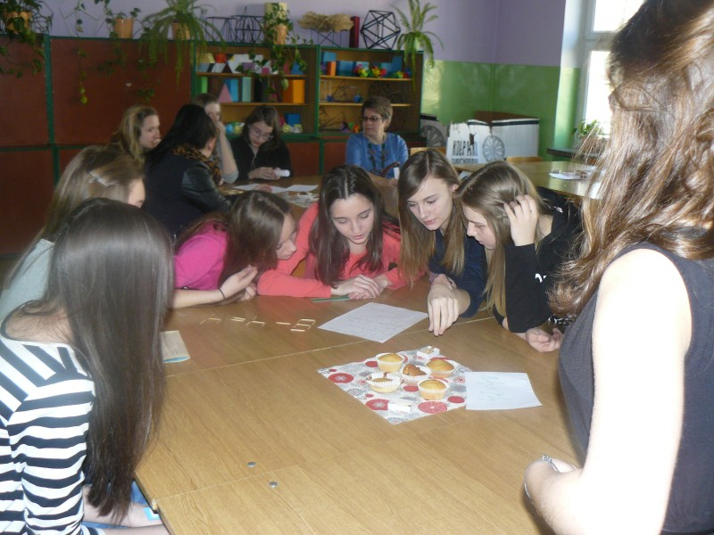
Youth mini-enterprises
At lessons students prepare and start their own enterprises.
Within the project students create their own brand, they create goods, sell them, get involved in marketing and accounting.
Our students have already made eco-bags, holiday ornaments, jewellery and stationary.

Slide 14
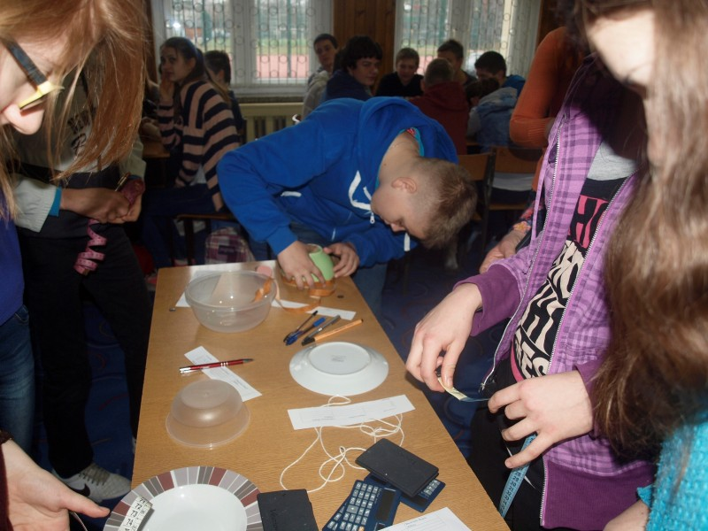
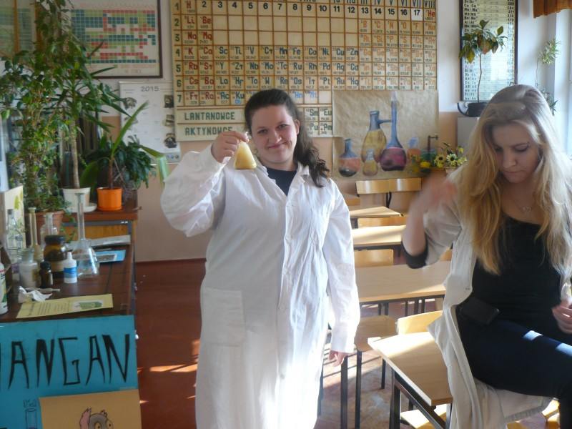
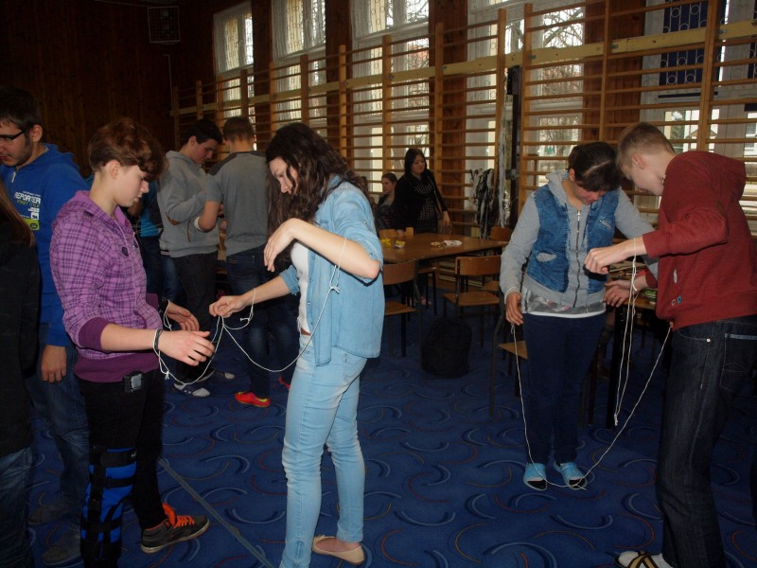

Slide 15
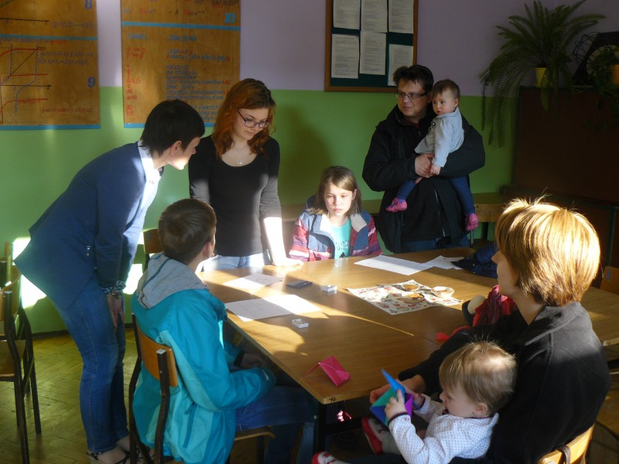
Classes with school tutor and form teachers
self-discovery,
closer look at students’ occupation aptitudes,
trips to different companies.

Slide 16
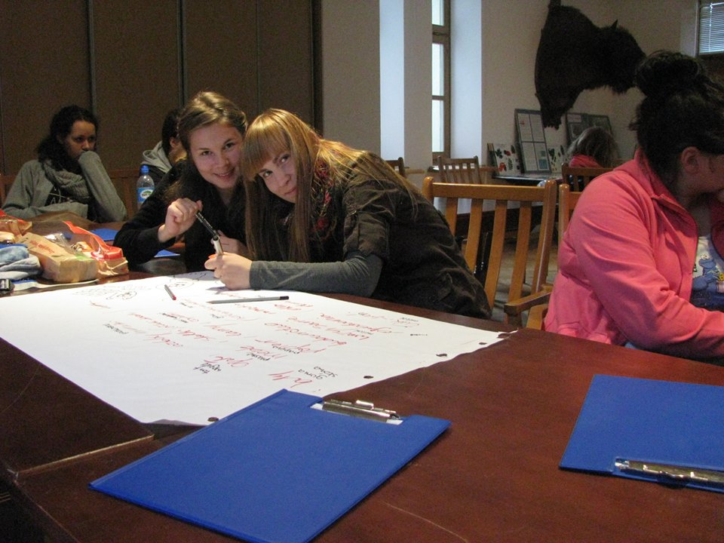
During the classes of Enterpreneurship Basics and Economics in practice our students accquire skills and knowledge about:
Ways of looking for a job, writing CVs and personal statements, self-presentation, workers' appurtenances,
Types of employment and salaries of employees,
Unemployment problem in Poland,
Abroad working opportunities,
Starting your own business,
Embracing bank services

Slide 17
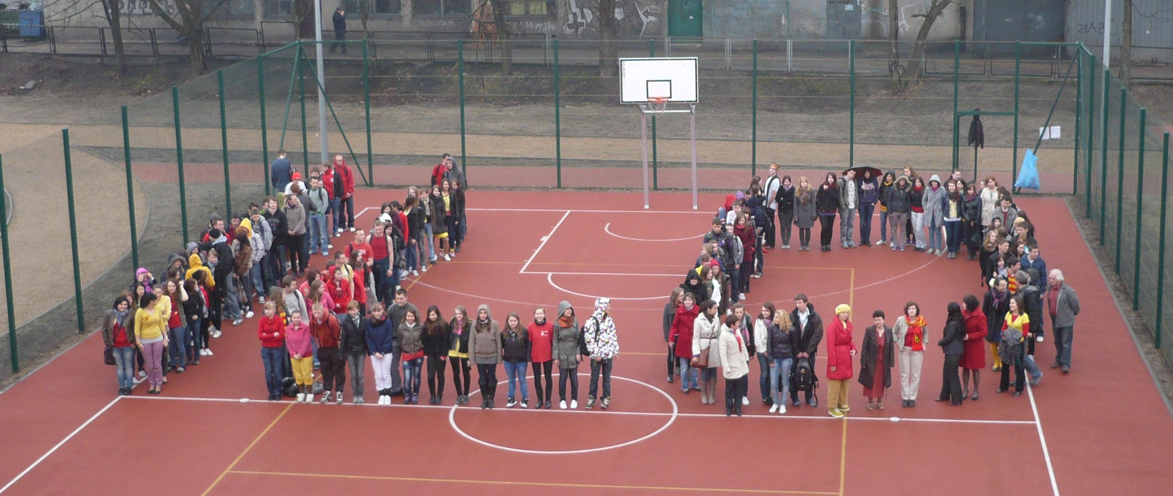
Thanks for your attention!

