Slide 1
CV-Europass project
ERASMUS+ 2015-1-DE03-KA219-013522_5
"Career perspectives in Europe - Chances and challenges"

Slide 2
Our CV…
pdf

Slide 3
… And Cover Letters
pdf

Slide 4
pdf

Slide 6
Meeting with Simon Barks
During the workshop we met Mr Simon Barks. A manager of the human resources department of a chemical industry.
His job is to give to young people instruction about the right way to find job.
He came for showing us how a work interview is , with a simulation.

Slide 7
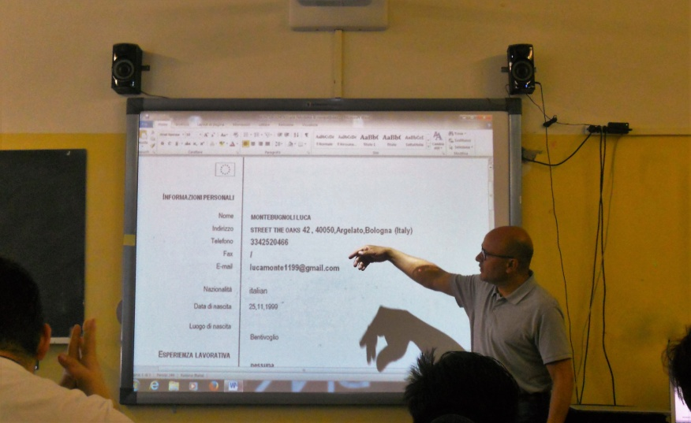
We talked about:
The right way to display our abilities
and our work experiences.
How to behave during a work interview.
The importance of our body language.

Slide 8
The right way to display our abilities
and our work experiences.
Don’t be afraid to talk about your achievements or your abilities.
It’s of extreme importance for you that your interviewer knows what you can do in order to get the job.

Slide 9
How to behave during a work interview
During an interview it’s very important to keep calm and collected.
Be careful not to let your anxiety show and make a fool of yourself.
It’s also bad to give the impression of thinking that you’re “too good” for the job.

Slide 10
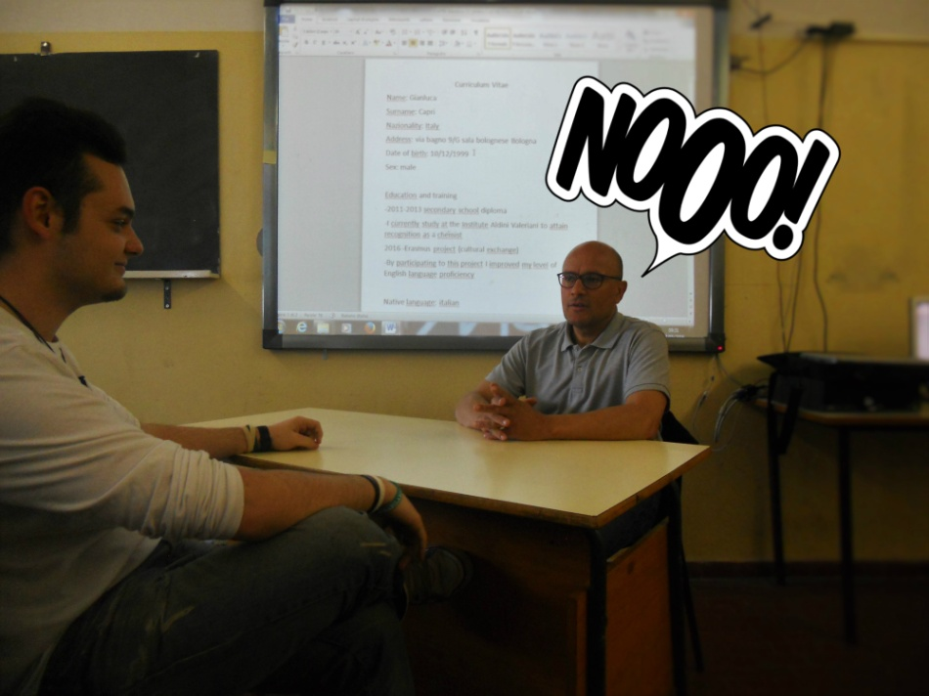
Two things that you don’t do when you are talking with your work examiner
Your posture is very important in an interview. You have to try your best to give a vide of self esteem and reliability. Keep your back straight and don’t bend over or you may risk to look lazy and uninterested, and nobody wants to hire a lazy guy.

Slide 11
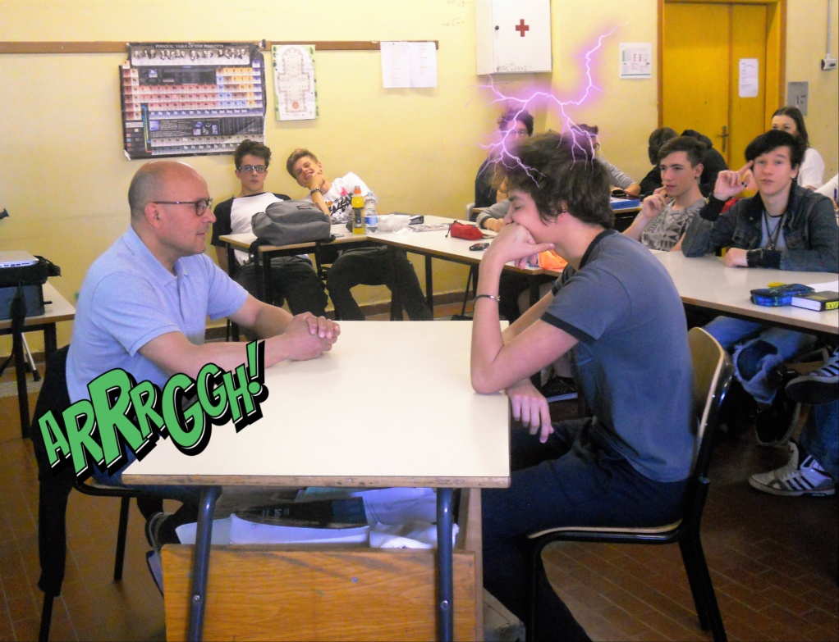
Two things that you don’t do when you are talking with your work examiner
Don’t make too many strange movements and keep a professional and appropriate pose, look confident but a little submissive, keep your forearms on the table and relax your shoulders. Do not look bored, or tired, or too agitated but keep your calm and a straight face. And remember smiling won’t kill you.

Slide 12
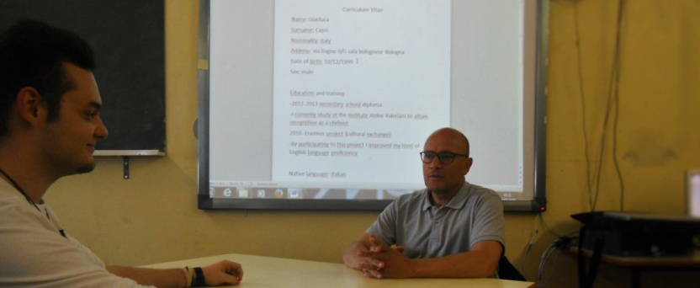
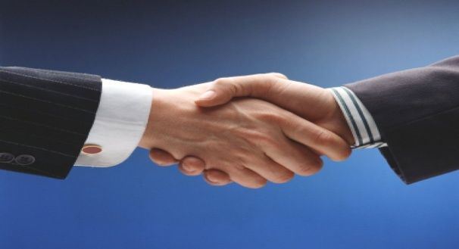
Two things that have to do when you meet your work examiner
Remember to keep eye contact with your interviewer. If you find it too hard to look at him in the eye try looking at his brow, he most-likely won’t notice it and you will make a better impression.
Remember that a strong handshake is the right way to show your trust on your self. This is a banal gesture but its very important to understand your personality.

Slide 13
ERASMUS+
2015-1-DE03-KA219-013522_5
"Career perspectives in Europe - Chances and challenges"
Thank you for the attention
Danke für die Aufmerksamkeit
Dziękuję za uwagę
Bedankt voor uw aandacht
Andrea Brighenti
Alessandro Pulizzi
Tommaso Di Cesare
Fabio Bernardini
Andrea Trifoglio

